Slide 1

Final Capstone
Deep Learning (CNN) and Forecasting - Prediction of COVID-19.
Sajith Gowthaman
Data Science Trainee
Thinkful, Inc.

Slide 2
INTRODUCTION
Coronavirus (CoV) are a large family of viruses transmitted between animals and people that causes illness ranging from common cold to more severe diseases that affects the respiratory system.
This project is a combination of deep learning, forecasting and visualizations.
Visualization alone can only provide so much information. However, we could strengthen the analysis to improve the healthcare system by leveraging the application of data science and AI.

Slide 3
PROJECT AIM & DETAIL:
There are two parts to the project:
Performing prognostic prediction to find the presence of CoV in chest x-ray images using Convolutional Neural Network algorithms. The data for this part of the project was taken from an open Github repository (https://github.com/ieee8023/covid-chestxray-dataset.
Visualization and prediction of positive COVID-19 cases using a real time data from “COVID-19 Tracking Project” (https://covidtracking.com)

Slide 4
PART - 1 DEEP LEARNING
IMAGE CLASSIFICATION OF COVID-19 CHEST X-RAYS
AIM: To classify and predict the presence of CoV in the chest x-rays.
• The data consists of 350+ images of Covid-19 victim’s chest x-rays (2k+ after augmentation).
• The normal chest x-ray images were taken from Kaggle.
• Concepts used: Keras (TensorFlow as backend), CNN, Augmentation, Activation, Padding, BatchNormalization, Regularizers, Dropouts, Softmax Activation, pretrained model and Matplotlib

Slide 5
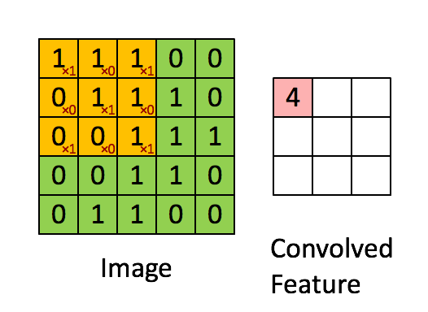
CONVOLUTIONAL LAYER
• CNN is used to understand and learn complex chest x-ray images with pixel dependencies. It can capture Spatial and Temporal dependencies.
• Convolutional Neural Networks is used to differentiate images through learnable weights and biases.

Slide 6
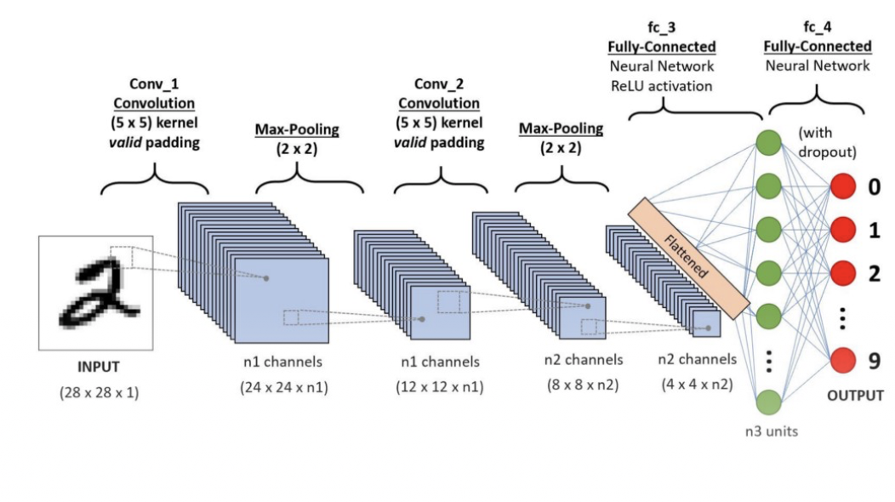
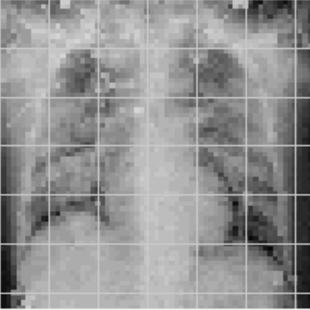
WORKFLOW/PIPELINE
• The pictures are first pre processed, reshaped to 64x64x3 for feeding it into the model
• We will move in the direction of the pipeline starting from convolutional layer, Maxpooling, Batch Normalization, fully connected layer output

Slide 7
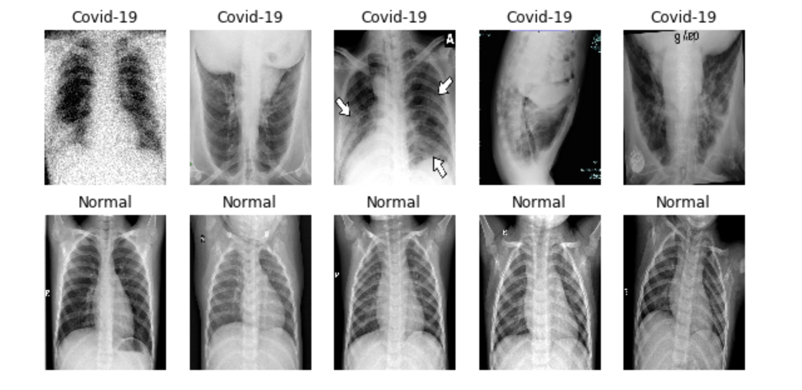
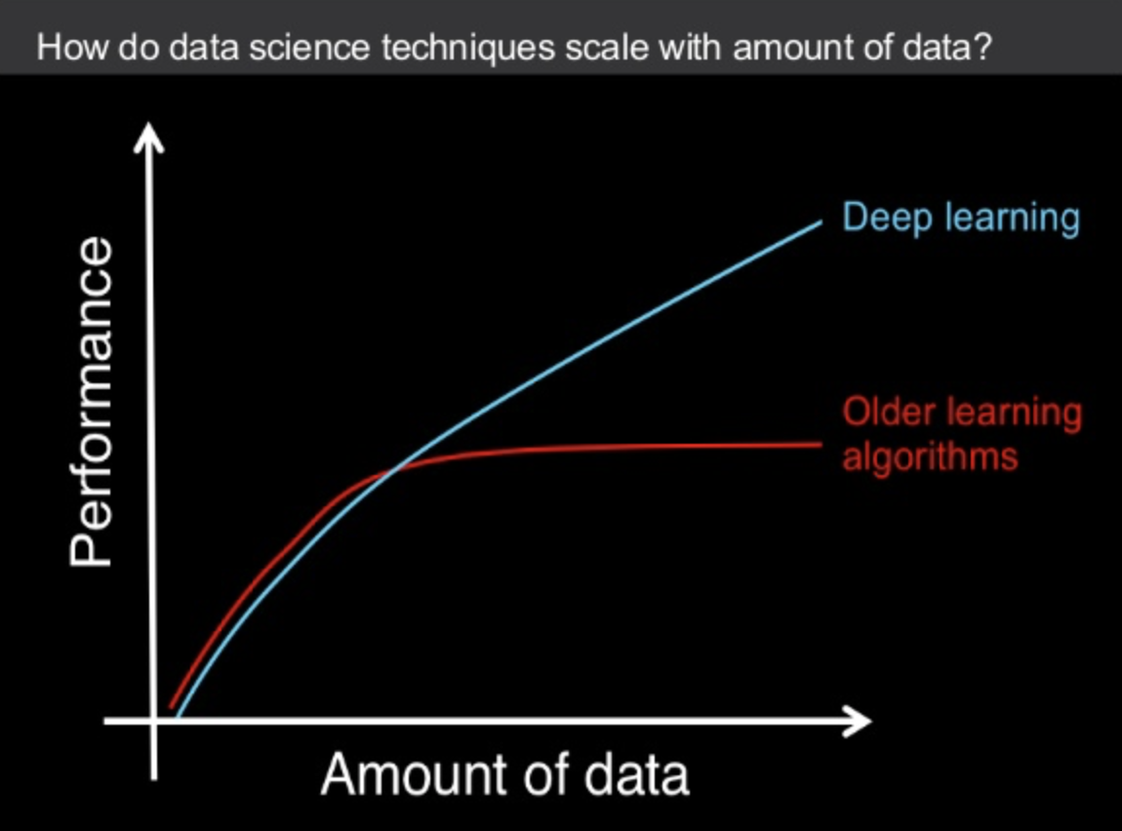
GENERATING DATA:
• Image Data Generator : This is used to automatically generate data while training the model.
• AUGMENTATION: Manually duplicating images to produce larger training data (flipping, rotating, etc.).
• VGG-16: This is proven pre-trained model, whose weights and activations can be used in other models.

Slide 8
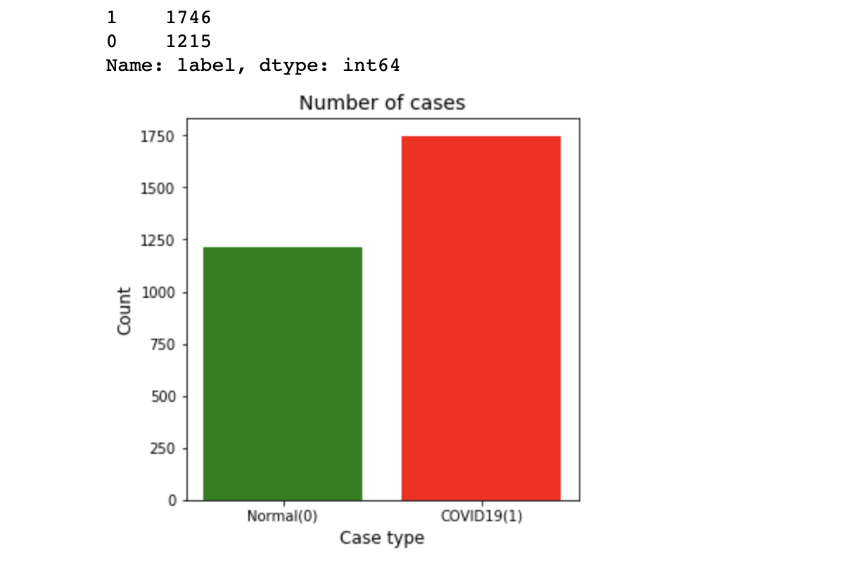
DATA PROCESSING
• The CoV chest-xray images were augmented to about 2000 in count. The CNN model works better with more images.
• The Images were all resized to 64x64.
• The Labels for CoV x-rays were given as 1, and Normal chest x-rays as 0.

Slide 9
CNN ARCHITECTURE
• Visible input layer of image size 64x64x3 (width x height x rgb) and kernel size 3x3
• Activation - “Relu” which defines the output of a neuron to either 0 or better value.
• Regularizers - Kernel regularizer - L2(0.01) - which penalizes the weight to get better fit.
• Padding - Two types: “Valid” which will reduce the size and “Same” that preserves the size.
• MaxPooling - Reducing the dimension, while preserving the most important aspects.
• Filter size: Filters are used to recognize and learn the patterns, which is moved by strides (1,1).
• Output layer with “Softmax” activation to get the output in the form of probability.

Slide 10
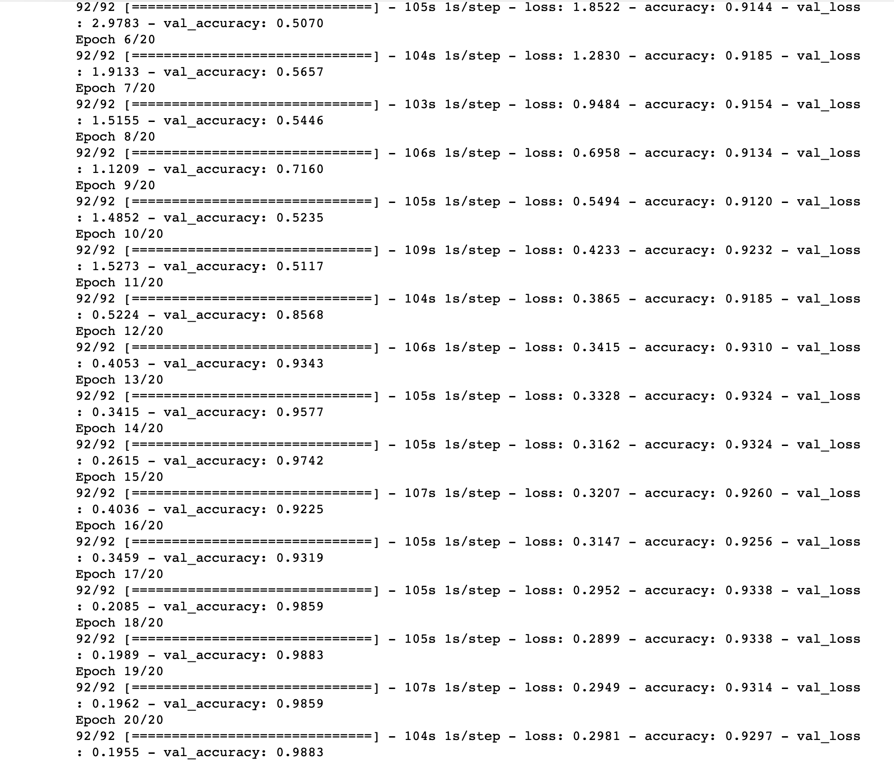
TRAINING THE MODEL
• The test accuracy increased from 50% to 97%.
• The training accuracy increased from 80% to 93%.
• The loss associated with the model fell from 11 to 0.26

Slide 11
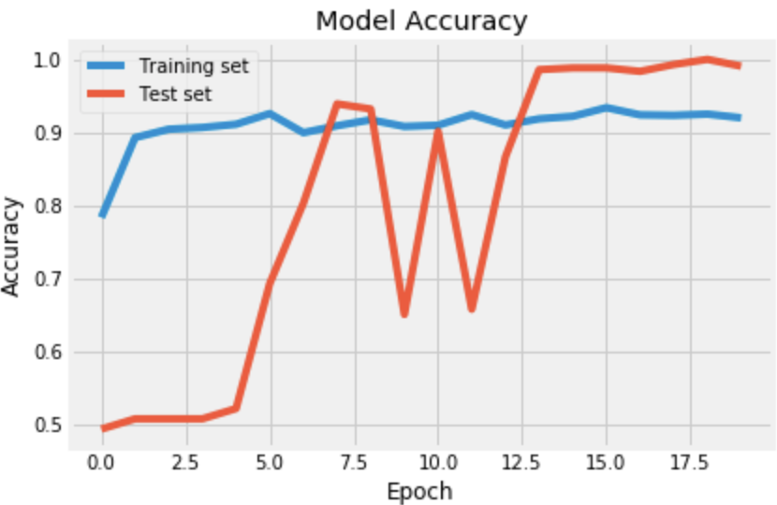
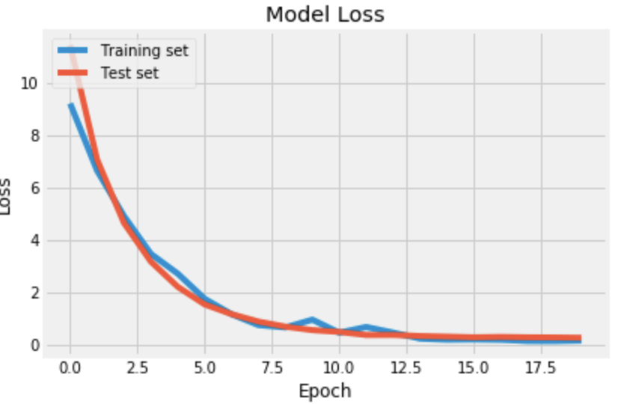
TUNING THE ACCURACY
Using weighted regularization to keep the weights as low as possible for better generalization kernel_regularizer=regularizers.l2(0.05).
Increasing training set, which was performed by rotating, flipping and adding noise.
Used VGG-16 for transfer learning due to the small data size.

Slide 12
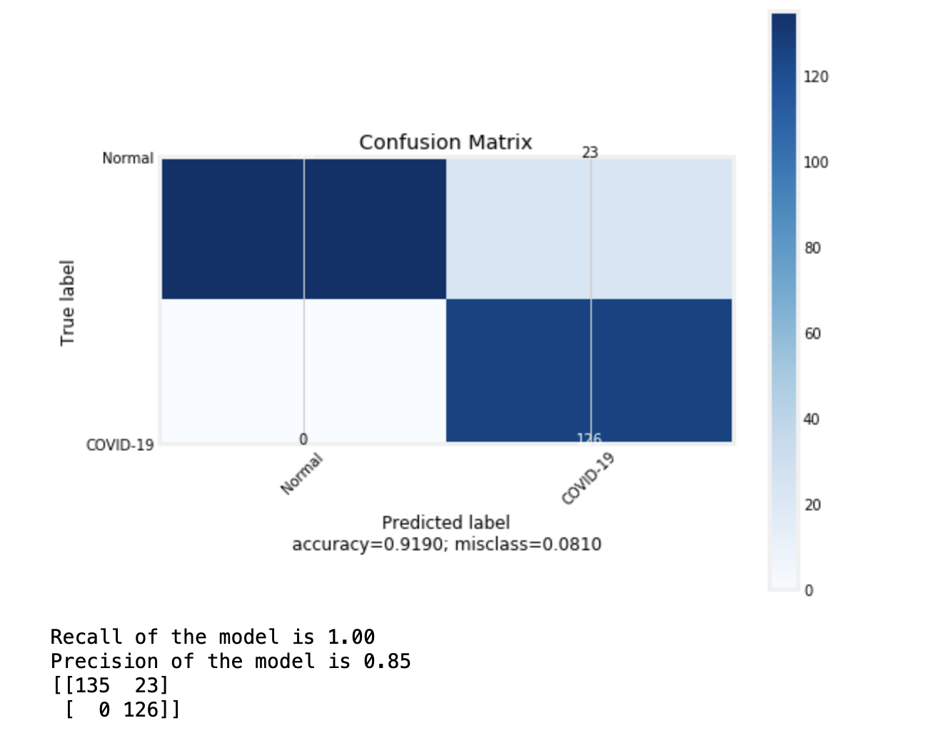
ACCURACY & CONFUSION MATRIX
• No false positive or false negatives for Normal Chest X-rays.
• The model is was able to predict about 126 Covid-19 images correct (True positive) and 23 images incorrect (false positive).
• Training accuracy: 92%
• Test accuracy: 98%
• Loss on test: 29%

Slide 13

PART-2 FORECASTING
Data Structure and Aim:
We will forecasting the positive cases using ARIMA and FB Prophet.
For visualization, the top 10 states that are affected are taken.
This is a time series data, consisting of records since the beginning of outspread (January 2020).

Slide 14
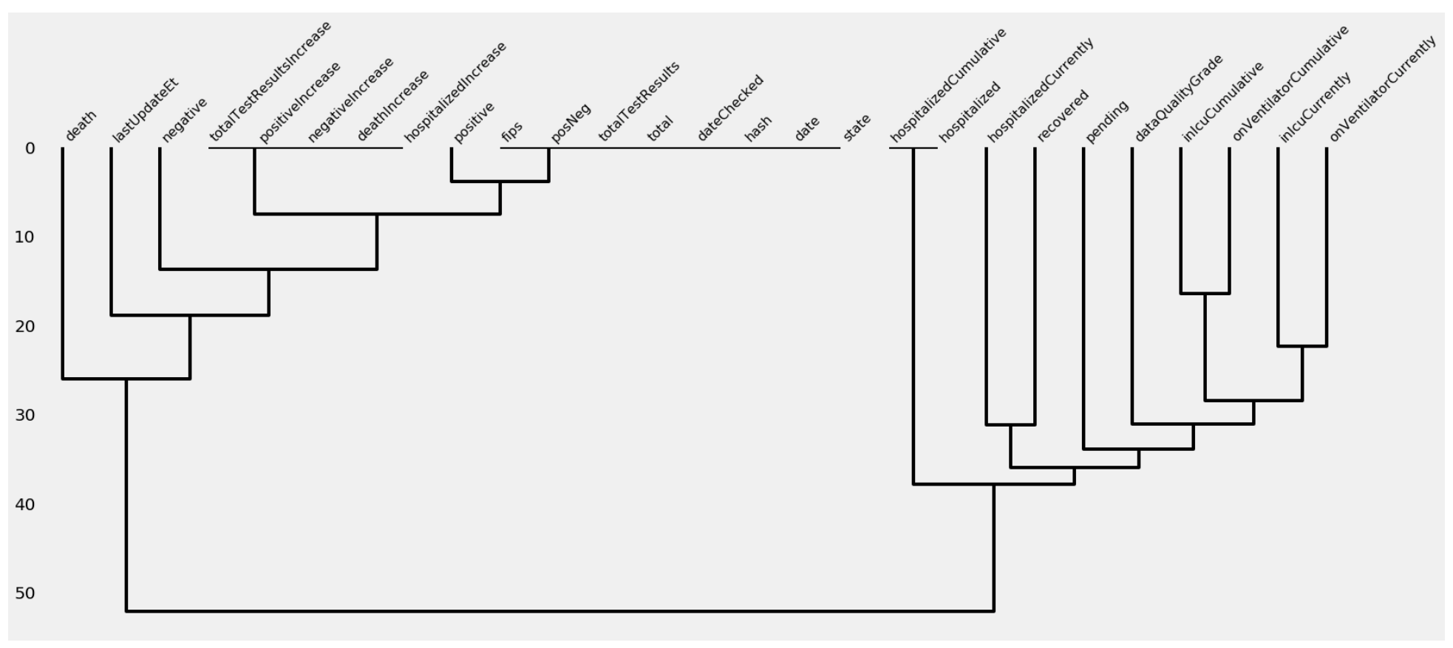
EXPLORATORY DATA ANALYSIS (EDA)
The date was converted to Datetime format using Pandas.
The Null values were plotted to understand the structure of the data feature better.
The dates til March-12 were dropped.

Slide 15
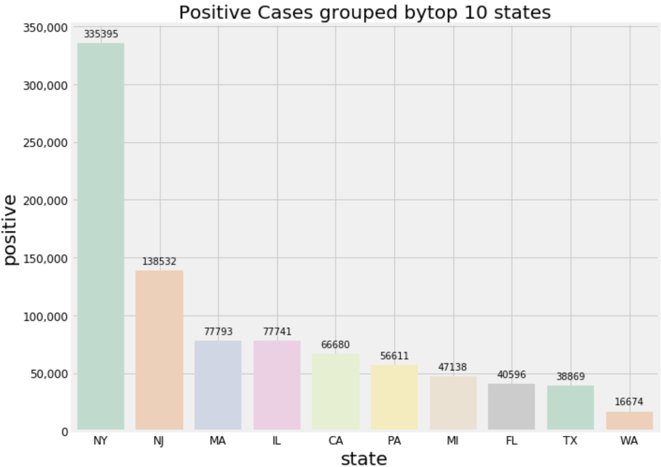
STATE-WISE POSITIVE CASES
• New York and New Jersey are at the top of the list.
• This is because of the high population in New York City, where there is an average of over 27,000 people per sq. mile according to 2010 Census.

Slide 16
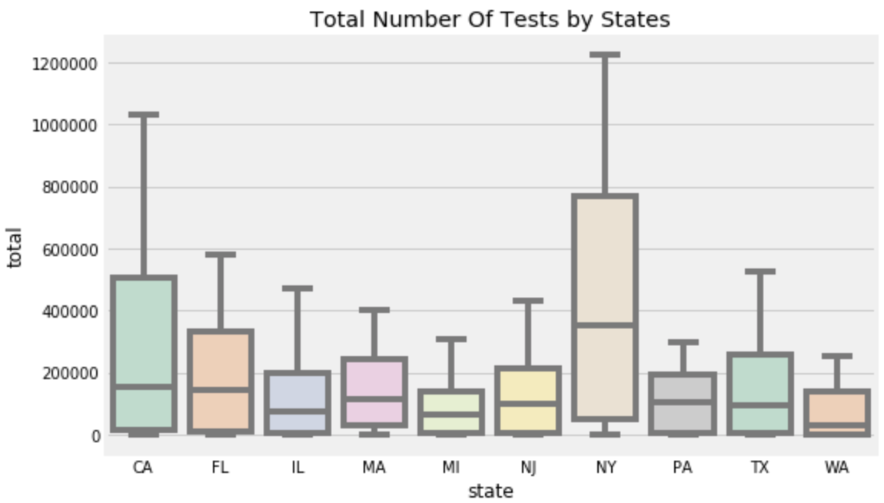
TOTAL TEST RESULTS
• Not to mislead you, CA contributes to 18% of the total results and not the positive cases.
• NY with 23.1%, CA with 18.6% followed by FL with 10.5%. These states had the highest number of tests as of May 10, 2020.

Slide 17
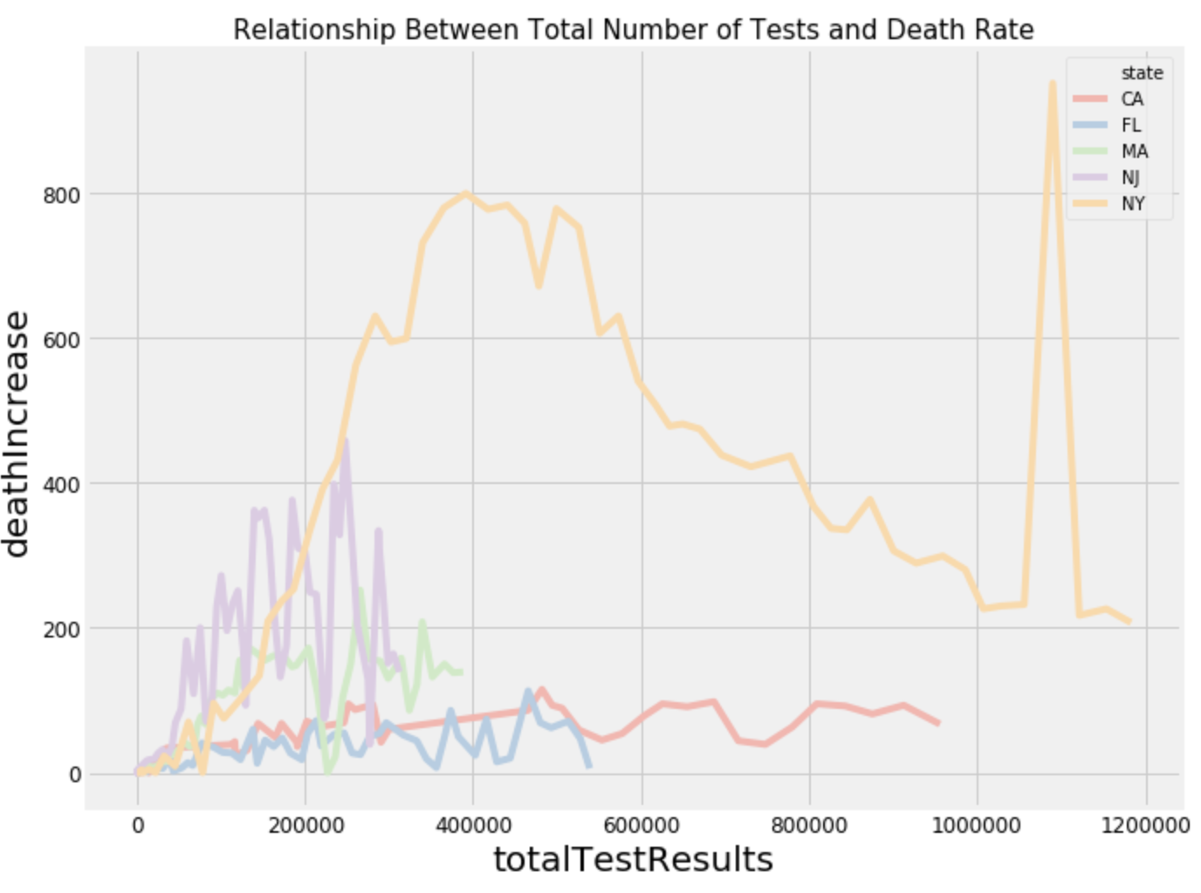
DEATH RATE
• The death rate is starting to decline with increase in number of tests.
• This could be due to victims who were tested positive and followed the right measures to restrict the virus from spreading further..

Slide 18
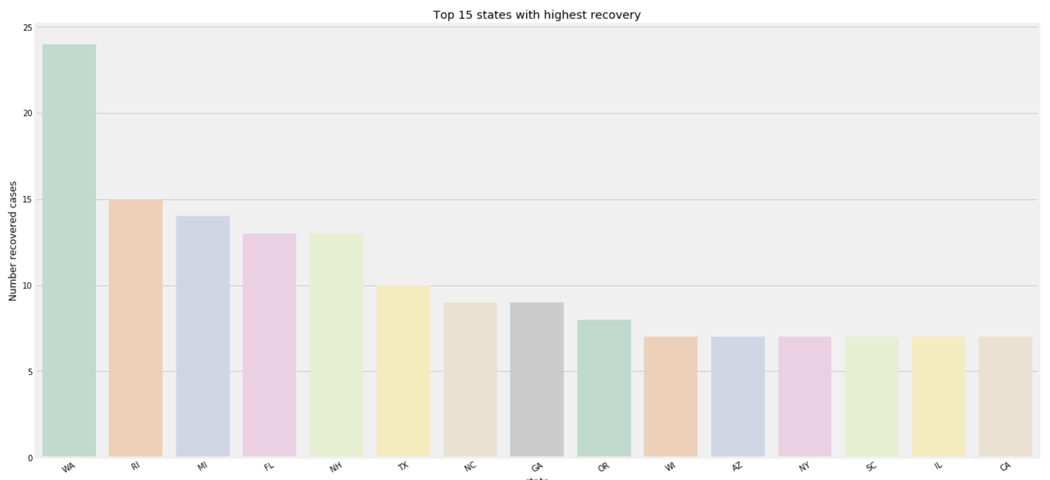
RECOVERY RATE
• From this plot we can infer that Washington had the highest recovery compared to other states.
• This is because of the wide-scale rapid testing across the state, health care and front line workers access to PPE, and abundance of protective supplies.

Slide 19
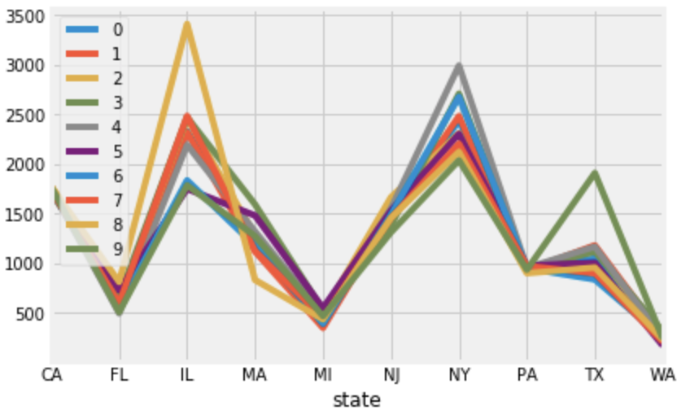
ARIMA
• ARIMA model of order (0,1,1) had the least AIC and BIC values as low as 72 and 73 respectively.
MAPE/RMSE:
• The model is predicting a high number of new cases in Illinois, which could be true. As of today, IL had the second highest new cases, first being NY.

Slide 20
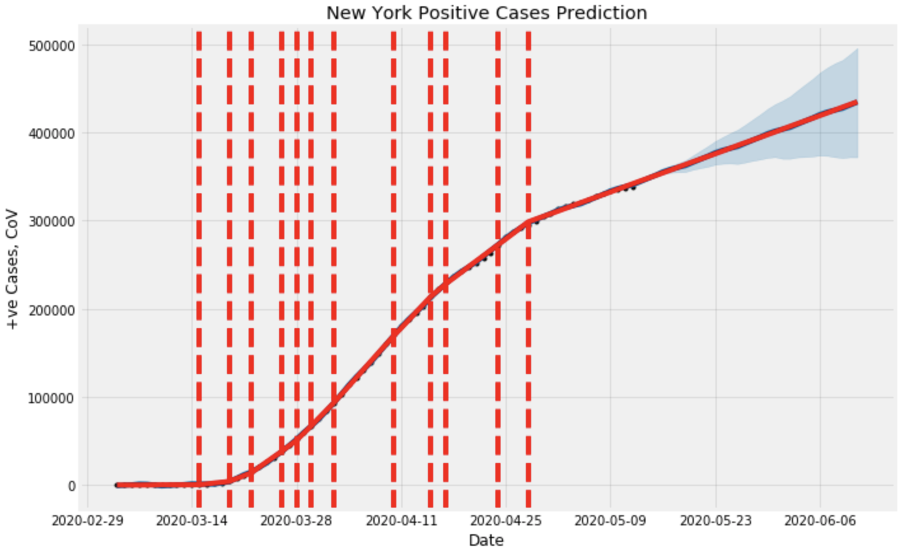
FB Prophet
• Predictions were made for a period of 30 days using FB Prophet.
• The positive cases of New York was predicted, and the cases seem to increase almost up to 450,000.

Slide 21
CONCLUSION FOR PART-2
The data was visualized for the top 10 countries that are affected, putting them in priority.
Washington State's recovery level is comparatively higher to other states.
New York is the highest affected state, however, the curve is starting to flatten from the peak.
The positive cases for New York were forecasted using FB Prophet.
The positive cases of all states were forecasted using ARIMA model for a period of 30 days.

Slide 22
OVER ALL CONCLUSION
• The images for the COVID-19 chest xrays were classified and evaluated with test data to get 92% test accuracy.
• The positive cases of New York are continuing to increase at least for the next 30 days.
• The positive cases for Illinois are increasing on a higher rate, all the other states are expected a mild increase for the next 10 days.
• Washington State has the highest recovery rate as of May 12.

Slide 23
THANK YOU!

